Slide 1
GPC presentation

Slide 2
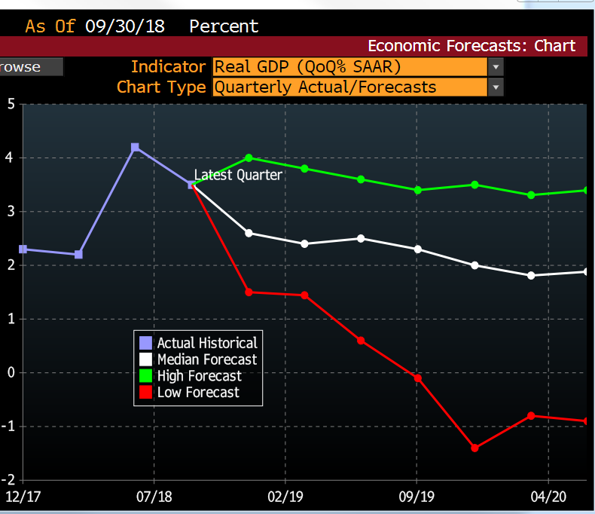
US GDP Growth to decelerate

Slide 3
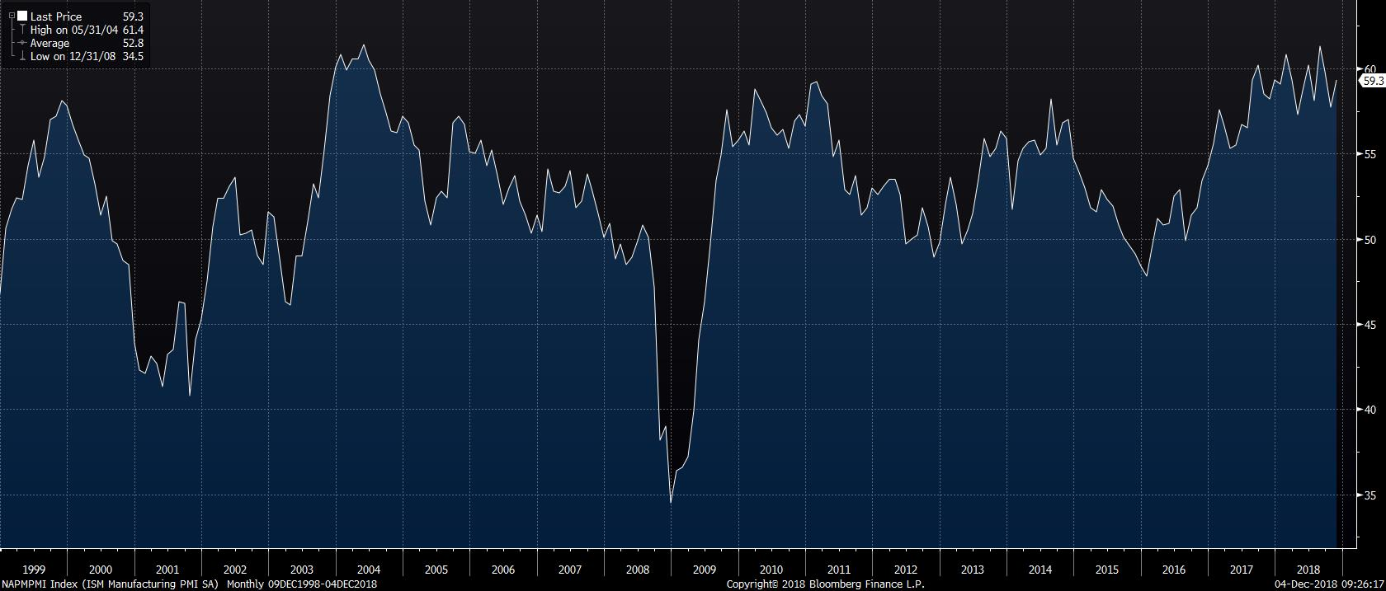
ISM Manufacturing index likely Peaked

Slide 4
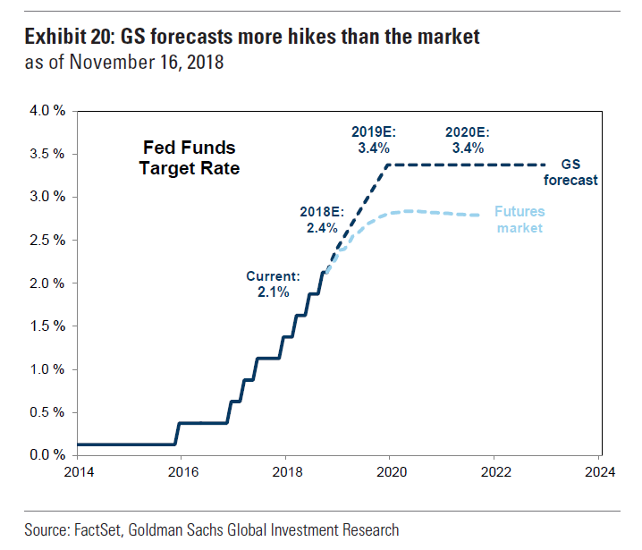
Fed rate Hike

Slide 5
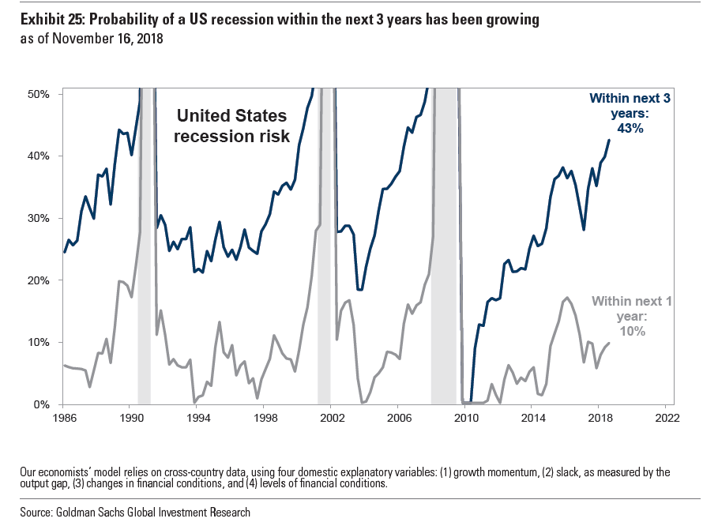
Recession Risk Rising

Slide 6
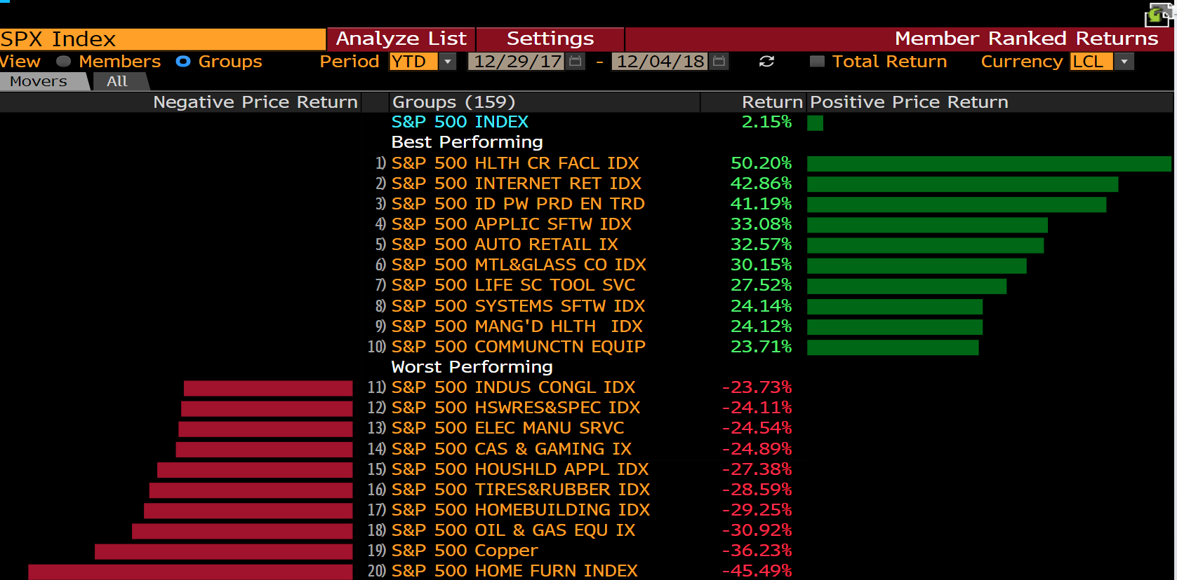
Cyclical Underperforming

Slide 7
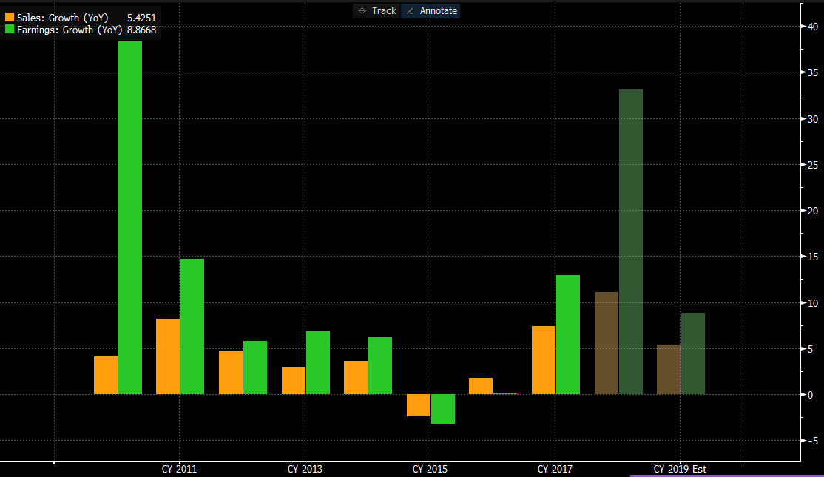
Decelerating SPX Sales and EPS Growth

Slide 8
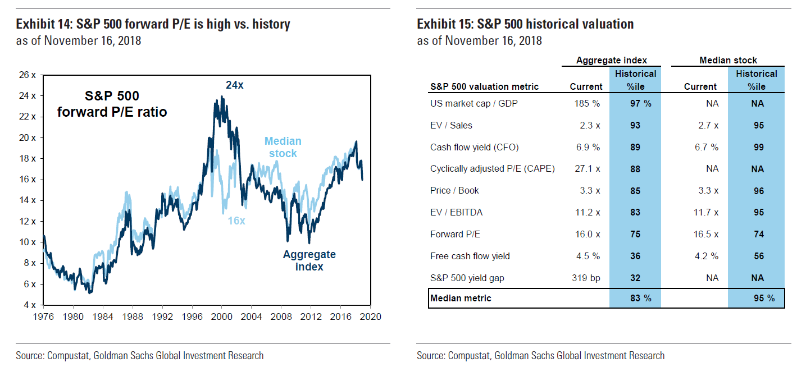
Valuation high relative to history

Slide 9
Downside vs Upside Risk
Downside Risk
Economy and manufacturing activity slowing
S&P top and bottom line growth decelerating
Fed Rate Hike and valuation contraction
Trade war
Upside Risk
Fed could back off rate hike
Trade conflict easing
Economic and earnings growth could remain stronger for longer

Slide 10
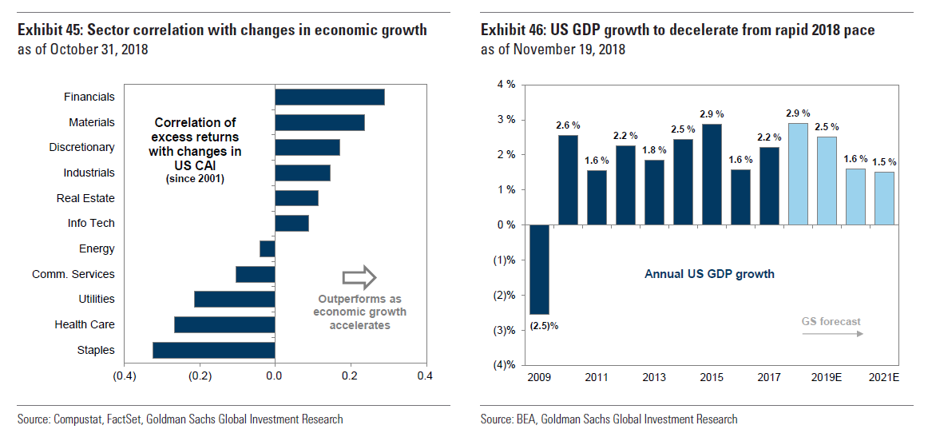
Sector Allocation in a decelerating environment

Slide 11
Sector Allocation in a decelerating environment
Defensive growth
Selective tech

